Slide 1

BY: Sarwat Majeed
Roll #: 00331141
Slot: Wednesday 7 to 10
Large Language
Models (LLMs)
BY: Sarwat Majeed
(Student Leader)
Roll #: 00331141
Slot: Wednesday 7 to 10

Slide 2
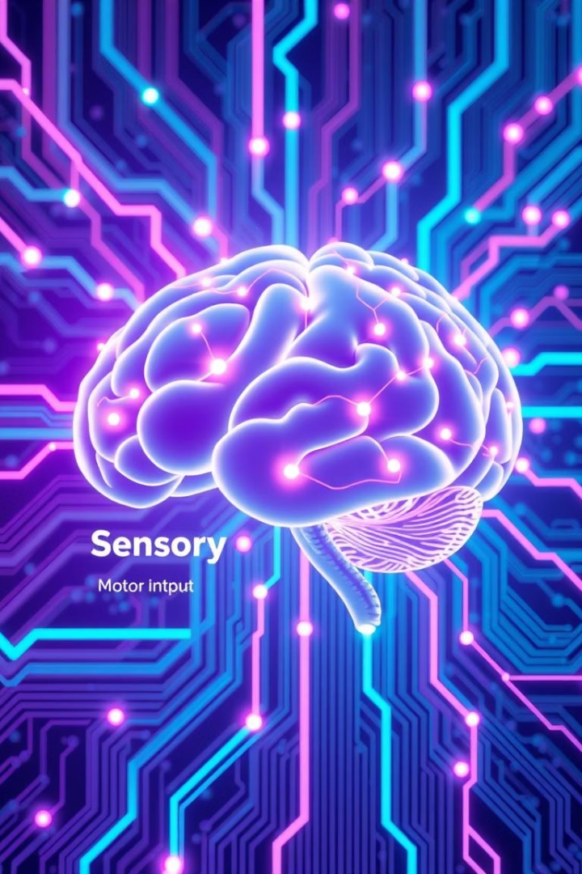
Understanding Large Language Models (LLMs)
Large Language Models (LLMs) generate human-like text by training on vast datasets. Examples include GPT-4, Bard, and LLaMA. They are revolutionizing industries with their versatile capabilities.

Slide 3

What Are Large Language Models?
Definition
Scale
Deep learning models with billions of parameters enable language understanding.
Examples: GPT-3 (175B), PaLM (540B), GPT-4 (over 1 trillion).
Training Data
Foundation Models
Trained on internet text, books, code, and diverse data sources.
Adaptable for many different language tasks across industries.

Slide 4





How LLMs Work: Training Phase
Self-Supervised Learning
The model predicts the next word in sequences without explicit labels.
Loss Function
Measures prediction errors to guide model improvement.
Backpropagation
Adjusts billions of parameters to minimize prediction errors.
Compute Power
Needs thousands of GPUs or TPUs over weeks or months of training.

Slide 5

How LLMs Work: Inference Phase
Prompt Engineering
Attention Mechanism
Focuses on relevant input parts for context-aware generation.
Creating precise input queries to guide model responses effectively.
Decoding
Tokenization
Breaking text into smaller pieces processed by the model.
Generates text based on learned probabilities and context clues.

Slide 6

Use Case: Content Generation
Marketing Content
Jasper.ai
LLMs create blogs, ads, and social media updates fast.
Generates marketing copy, valued at $1.5B.
Copy.ai
Efficiency
Automates writing with $13.9M funding.
Produces ten times more content than humans.

Slide 7

Use Case: Customer Service
Automation
Ada Support
LLMs power chatbots and virtual assistants for fast support.
AI-driven service automation with $130M funding.
Cost Reduction
Intercom
Can cut support costs by up to 70%.
Uses AI to automate client interaction, valued at $1.6B.

Slide 8




Use Case: Code Generation
Writing Assistance
GitHub Copilot
LLMs help draft and autocomplete code efficiently.
1
AI pair programmer powered by OpenAI Codex.
2
4
Tabnine
Time Savings
3
Popular AI code completion tool with 1 million users.
Reduces coding time by up to 40%.

Slide 9
Conclusion: The Future of LLMs
Advancements
1
Models will grow larger, faster, and more efficient.
Integration
2
Embedded in diverse industries and daily apps.
Ethics
3
Focus on responsible AI development and fairness.
Impact
4
Changing how humans interact with technology forever.

